Slide 1


Abusing
Windows Hello
Without a
Severed Hand
DEF CON 32

Slide 2


whoami Ceri Coburn (@_EthicalChaos_)
Lives in Wales, UK
Software developer for 18 years within the DRM and security solutions space
Joined Pen Test Partners in August 2019
Dedicated to Red Teaming and offensive security tooling for the last 3 years
Speaker at DEF CON 31 and BSides
Author and maintainer of several open-source tools
Rubeus
BOF.NET
Okta Terrify
ThreadlessInject
SharpBlock
SweetPotato
BeaconEye

Slide 3

whoami Dirk-jan Mollema (@_dirkjan)
Located in The Netherlands
Hacker / Researcher / Founder / Trainer @ Outsider Security
Given talks at Black Hat / Def Con / BlueHat / Troopers
Author of several Active Directory and Entra tools
mitm6
ldapdomaindump
BloodHound.py
aclpwn.py
Co-author of ntlmrelayx
ROADtools
Blogs on dirkjanm.io
Tweets stuff on @_dirkjan

Slide 4
Agenda
Introduction to Windows Hello
Relationship between Key Storage Providers
Windows Hello containers, protectors and keys
Tool demo
Unprivileged Entra Abuse
Mitigations

Slide 5
Windows Hello
Passwordless technology for Microsoft Windows
Key pairs for encrypting secrets or signing data, including authentication to the OS
Keys typically protected by biometric devices or PIN
Third party applications can also enrol secrets
Windows Hello vs WHfB
Windows Hello encrypts the user's password or uses live.com based certificate
WHfB uses tenant specific certificates which also support models for on-premises SSO via 3 trust types

Slide 6
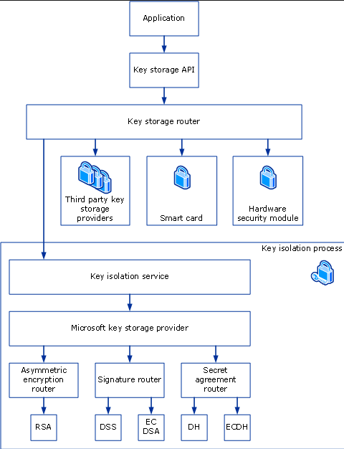
Passport Key Storage Provider
Windows has a common API for dealing with cryptographic operations via KSP’s
Extensible system via providers
Microsoft Software Key Storage Provider (RIP)
Microsoft Platform Key Storage Provider (TPM)
Microsoft Smart Card Key Storage Provider (Smart card duh)
Supports encryption, signing and key agreement among other things
Windows Hello is no different
Microsoft Passport Key Storage Provider
https://learn.microsoft.com/en-us/windows/win32/seccertenroll/cng-key-storage-providers

Slide 7
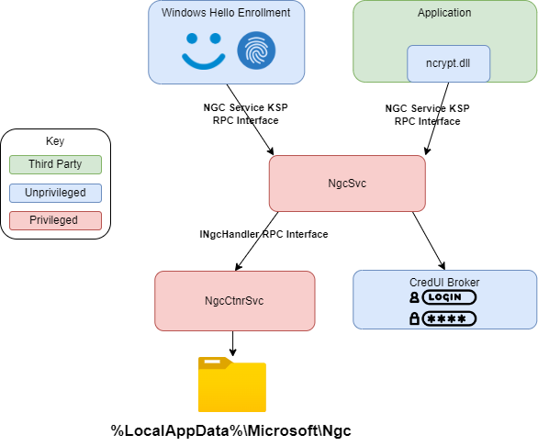
Passport Key Storage Provider
Offered via the NgcCtnrSvc and NgcSvc services
Exposed via RPC calls
Metadata for generated keys stored under the LocalService account at %LocalAppData%\Microsoft\Ngc
SYSTEM privileges needed to access Ngc folder

Slide 8
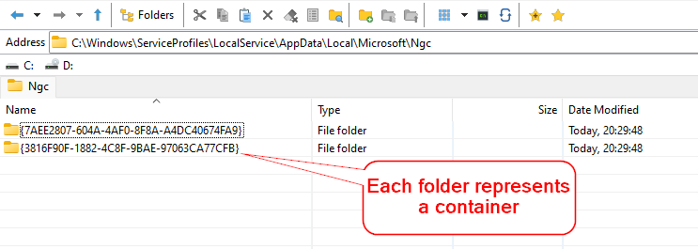
Passport Key Storage Provider
Passport Key Storage provider is a proxy to other KSP’s
Under the hood either uses Software Key Storage Provider or Platform Key Storage Provider
Metadata contains
Containers
Protectors
Key metadata
Keys are stored via underlaying KSP

Slide 9
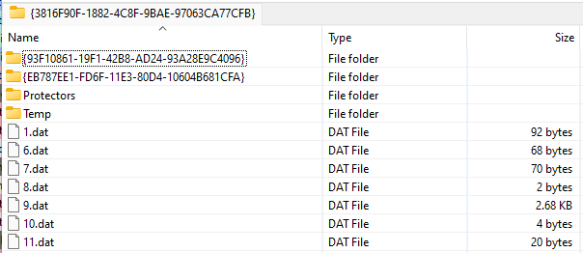
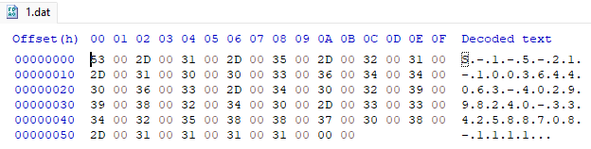
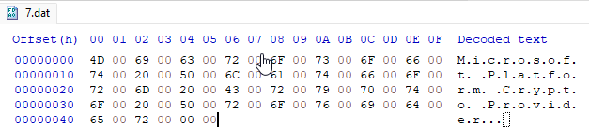
Containers
Container is created per user
Metadata files determine attributes of container
1.dat => User SID
7.dat => Backing KSP
9.dat => Azure recovery key (more on that later)

Slide 10
Protectors
Protectors are the enrolled Windows Hello authentication methods
Common metadata files
15.dat => Encrypted protector data
Decrypted protector data contains 3 intermediate PINs
Sign
Decrypt
External?
5 known types of protectors
1 – PIN protector
2 – Bio protector (both Face and Fingerprint)
3 – Azure recovery protector
4 – Seems to be missed, guess someone couldn’t count
5 – Preboot protector
6 – Companion device protector (deprecated after Windows 10, version 2004)

Slide 11
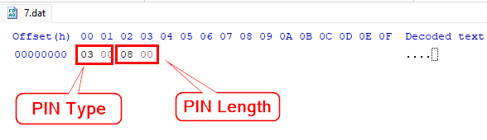
PIN Protector
Can be alphanumeric
Length stored within metadata (numeric only)
Metadata files
1.dat => KSP used for encrypting protector data
2.dat => KSP key id (software only)
7.dat => PIN type and length
Industrial Security Research Group already provided research in this area for non TPM scenarios
https://www.insecurity.be/blog/2020/12/24/dpapi-in-depth-with-tooling-standalone-dpapi/

Slide 12
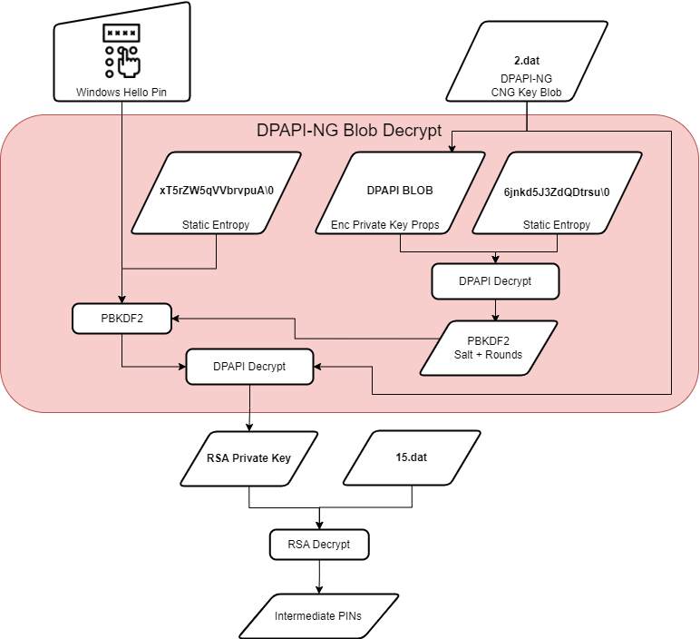
PIN Protector (Software Decryption)
Contents of 15.dat is RSA encrypted
2.dat contains key ID
Private key backed by Software KSP
Software KSP uses DPAPI-NG Backed by SYSTEM DPAPI key
PIN + fixed entropy used as password for PBKDF2 key
Salt and rounds for PBKDF2 is decrypted from the CNG key blob
Resulting key used as entropy for normal DPAPI decryption

Slide 13
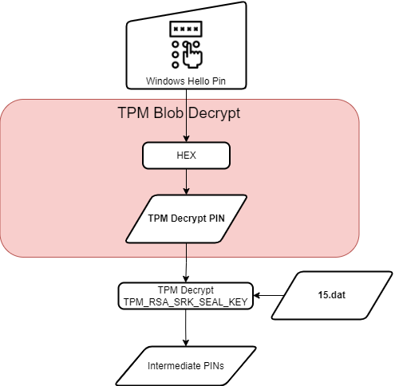
PIN Protector (TPM Decryption)
Contents of 15.dat is TPM encrypted
Private key backed by TPM KSP
No DPAPI backed blobs
Metadata files
1.dat => KSP used for encrypting protector data (Platform KSP)
2.dat => No longer present
7.dat => PIN type and length
Key id is fixed (thanks Mimikatz)

Slide 14
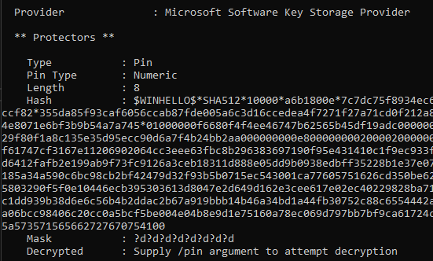
PIN Protector Abuse
TPM backed PIN protector is robust
TPM anti-hammering slows down brute force significantly
Software backed PIN protector = RIP
Length of numeric PIN already known
Targeted hashcat mask
Hashcat type $WINHELLO$ (28100)
Less that 8 digits cracked in seconds
Up to 11 digits cracked in days
Thanks to the WINHELLO2hashcat project for the inspiration

Slide 15
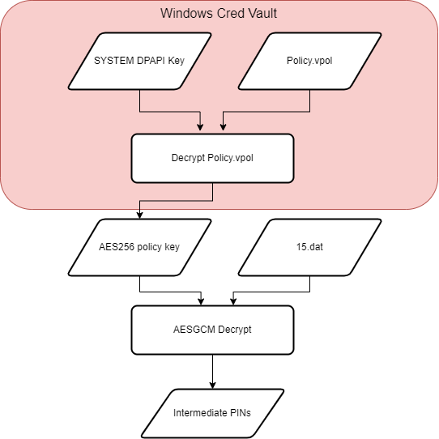
Bio Protector
Decryption key encrypted as Windows Vault credential
WinBio Key Resource Schema
Vault backed by DPAPI, TPM is not used
Decrypted vault credential contains AES128 and AES256 keys
AES256 key used to decrypt another AES256 key using CBC
Second key used to decrypt 15.dat using AESGCM
Metadata files
15.dat => Header + encrypted PIN’s
Header = Nonce, Tag, AuthData

Slide 16
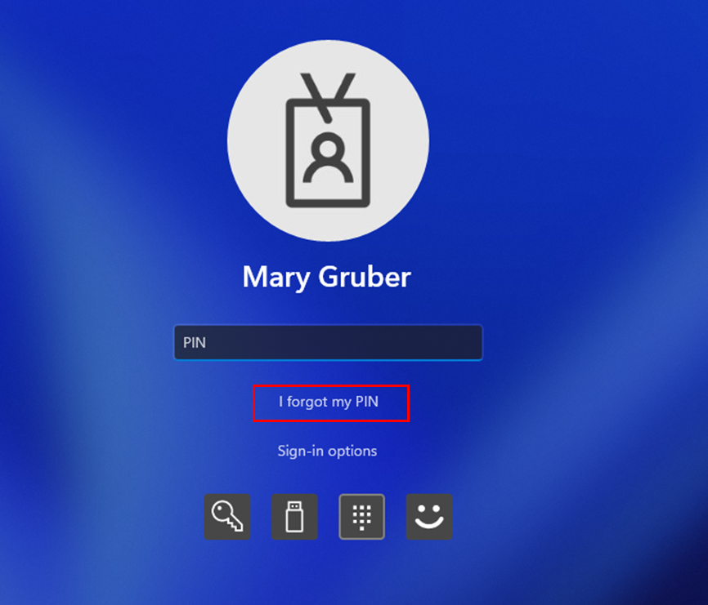
Recovery Protector
Used under WHfB scenarios
Allows user to reset forgotten Windows Hello PIN
Enrolled Window Hello keys continue to work after reset

Slide 17
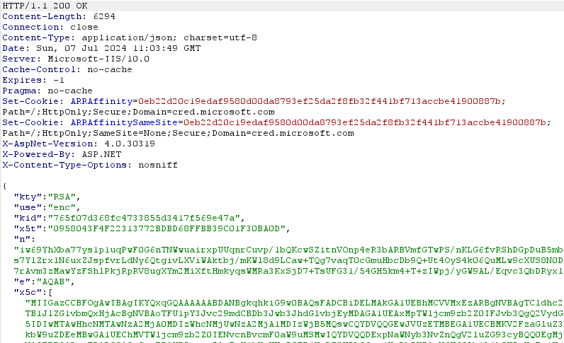
Recovery Protector
Protector decryptor key encrypted with local SYSTEM DPAPI key first
Encrypted key is encrypted with public key fetched from Entra
cred.microsoft.com/getencryptionkey/v1
Result stored inside 9.dat
Inside container folder not protector folder ¯\_(ツ)_/¯

Slide 18
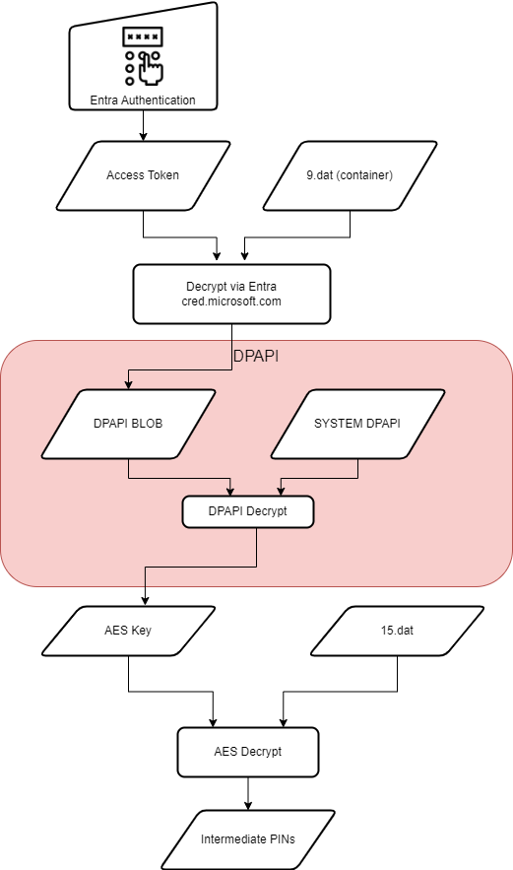
Recovery Protector
Decryption key is decrypted via Entra
POST cred.microsoft.com/unprotectsecret/v1
Access token requires ngcmfa and mfa claim
Client id 9115dd05-fad5-4f9c-acc7-305d08b1b04e (Microsoft Pin Reset Client Production)
Decrypted blob from Entra decrypted with local SYSTEM DPAPI key
Metadata files
15.dat => AES encrypted intermediate PINs
4.dat => AES IV
9.dat (protector) => Unknown
9.dat (container) => Encrypted Entra blob

Slide 19
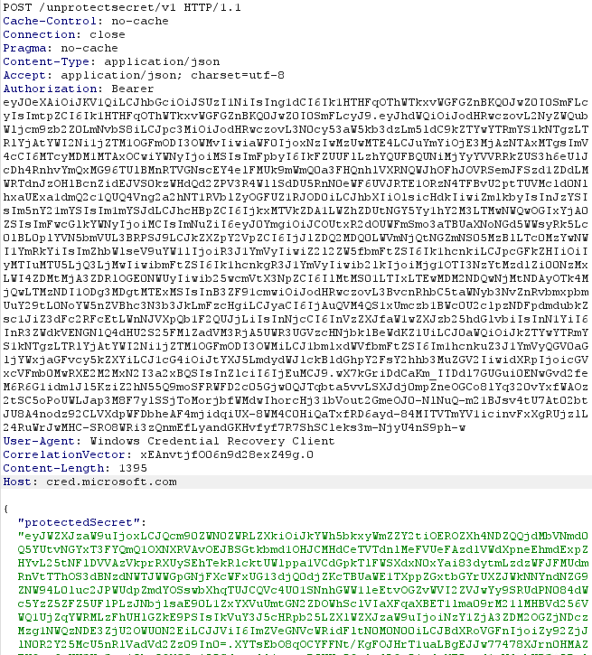
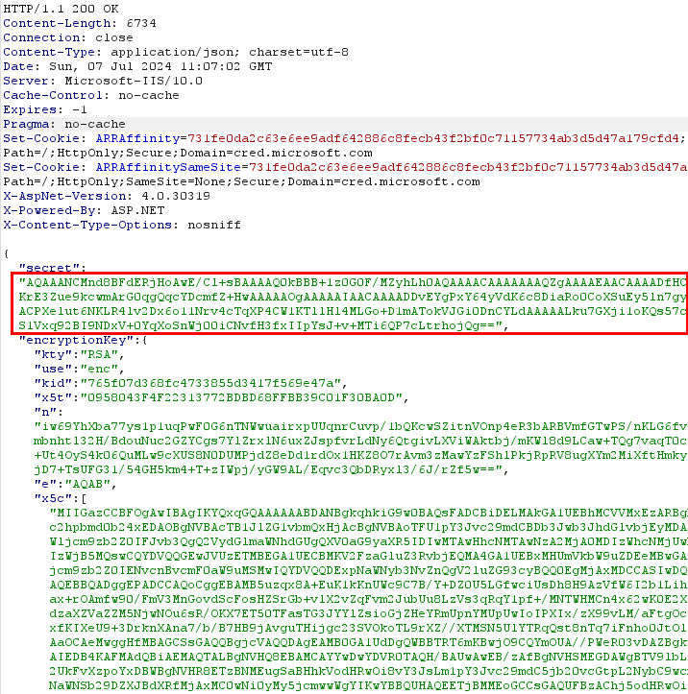
Recovery Protector

Slide 20
Preboot Protector
Used for devices that support BitLocker PIN to desktop
15.dat likely protected by BitLocker
More research needed

Slide 21
Companion device protector
Originally intended as external protector via companion device
Opaque blob sent to companion device for encryption
Probably the intermediate PINs
No research needed, deprecated and never seen irl.

Slide 22
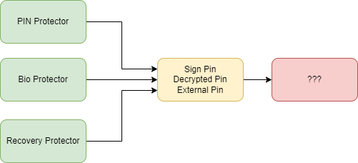
Protector recap
Protectors encrypt intermediate PINs
Inputs to protectors differ depending on type
Bio protector doesn’t need biometrics to decrypt
PIN protector is extremely vulnerable when no TPM is present
Intermediate PIN purpose?

Slide 23
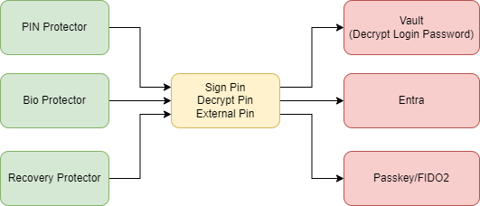
Keys
Intermediate PINs protect keys
Keys can be used for encrypting secrets or signing data
Key types
Vault key (Decrypt PIN)
Entra key (Sign PIN)
Passkey (Sign PIN)
Third party (External PIN)
Okta FastPass
Others

Slide 24
Keys
Keys once again leverage Software or Platform KSP depending on TPM presence
Key metadata also stored in dat files
Common dat files across all keys
Key specific dat files too

Slide 25
Vault Key
Vault key is used for decrypting plaintext password for Windows Hello
Leverages the decrypt pin from the protector as authenticator
Already covered in depth
Check out DPAPI-in-depth with tooling: standalone DPAPI https://www.insecurity.be/blog/2020/12/24/dpapi-in-depth-with-tooling-standalone-dpapi/

Slide 26
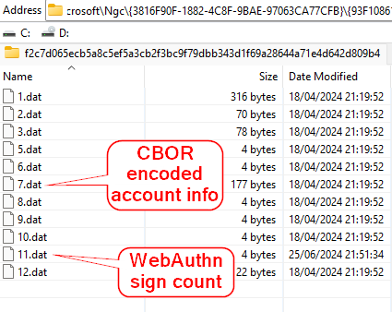
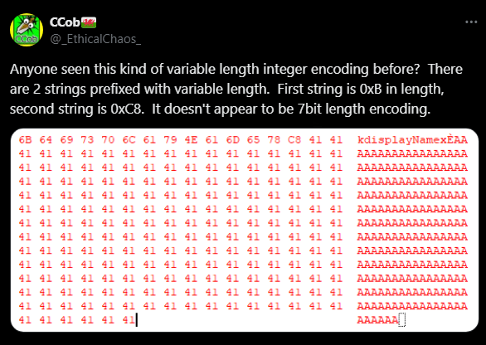
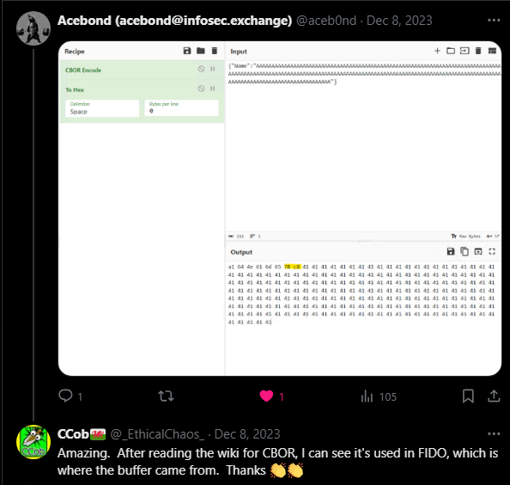
Passkey Key
Created when enrolling for WebAuthn/FIDO2/Passkey supported websites
Additional metadata files
Contains WebAuthn credential info encoded as CBOR
Shoutout to @aceb0nd who identified the correct encoding

Slide 27
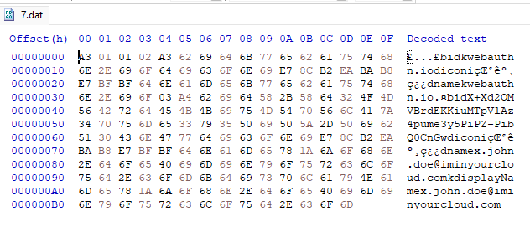
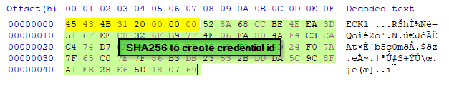
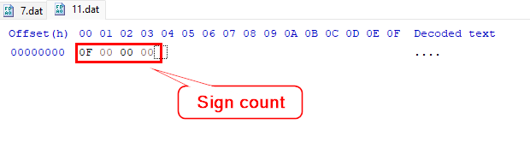
Passkey Key
CBOR data contains
Relay party id (RpId)
User id
Username
Display name
SHA256 of CNG key blob is the WebAuthn credential id
Incremental sign count stored in 11.dat
All the information needed to authenticate to WebAuthn

Slide 28
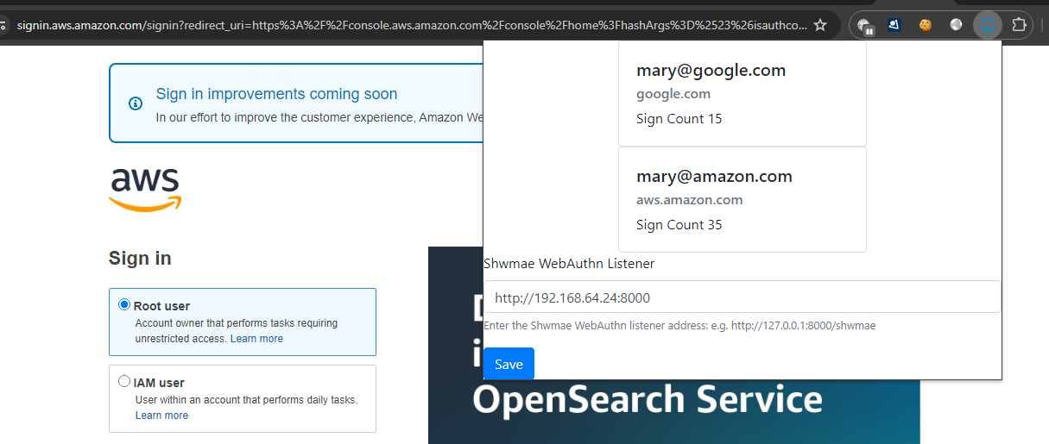
Passkey Abuse
Custom browser extension to hijack navigator.credentials.get WebAuthn function
Proxy assertion requests to compromised host
Increment sign count
Sign assertion and fake user presence
Return result back to extension
Profit

Slide 29
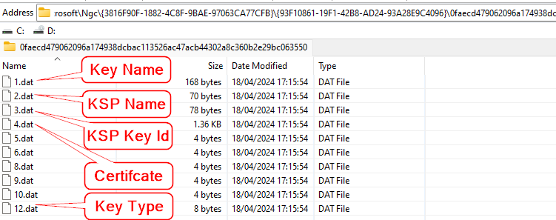
Entra Key
Created during WHfB enrolment
Used along with device certificate to request PRT’s
Can be used to obtain cloud TGT under Cloud Kerberos trust model
Leverages the signing pin from the protector as authenticator
Key name format contains tenant and user id
login.windows.net/de60a4fa-d583-4eb0-ab66-ce358af8279c/mary.gruber@ethicalchaos.dev

Slide 30
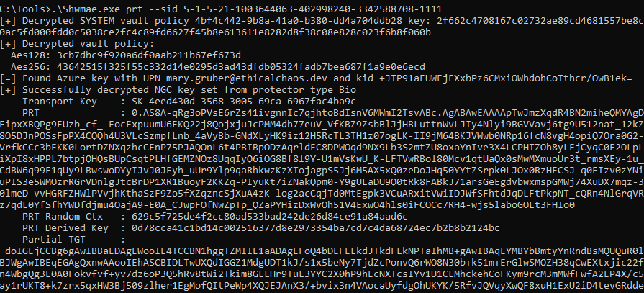
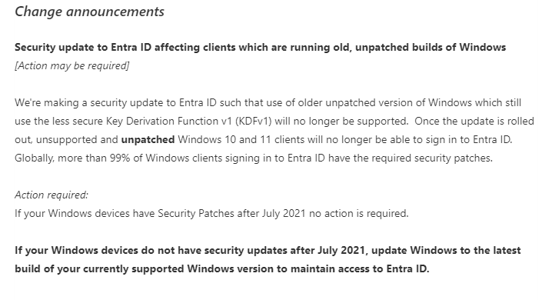
Entra Key Abuse
Direct request of new PRT’s leveraging the enrolled user key
The return of Dirk-jan’s CVE-2021-33781 via KDFv1 downgrade
Reported to MSRC
Conveniently deprecated in time for DEF CON

Slide 31
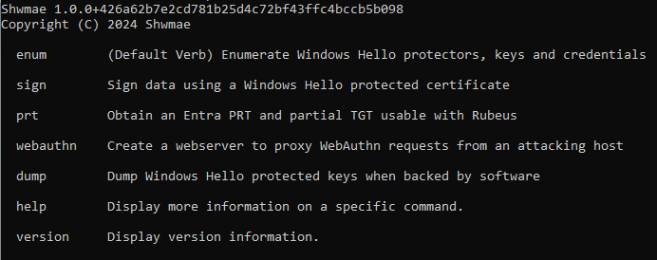
Introducing Shwmae (shuh-my)
New tool created to abuse the research presented here
Multiple modes of operation
Enumeration
Decrypts plaintext password when available
Dumps hashcat hash when possible
Dump keys
Only possible with software backed keys
PRT Authentication
WebAuthn Proxy
Arbitrary signing
Okta Terrify integration (TODO)
https://github.com/CCob/Shwmae

Slide 32
Demo Time

Slide 33
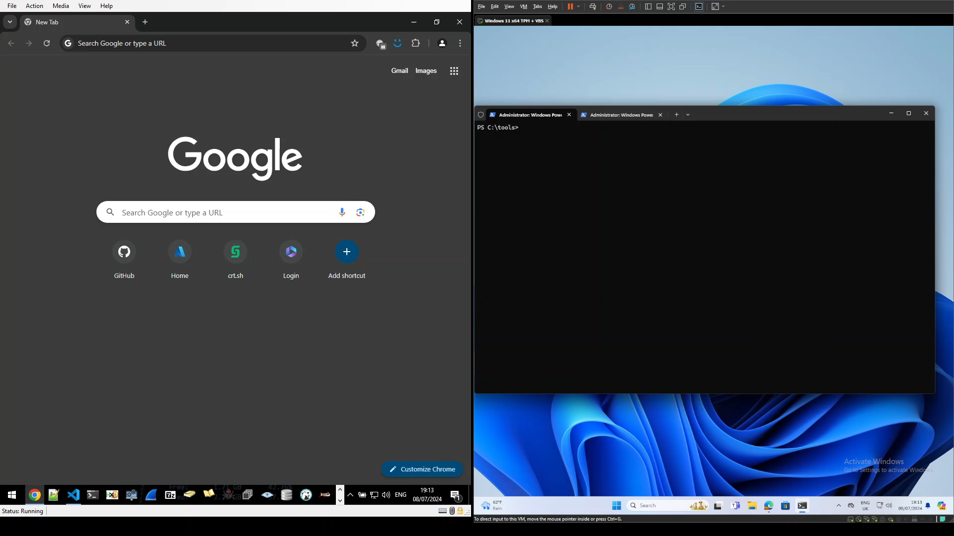

Slide 34
Unprivileged Windows Hello Abuse

Slide 35
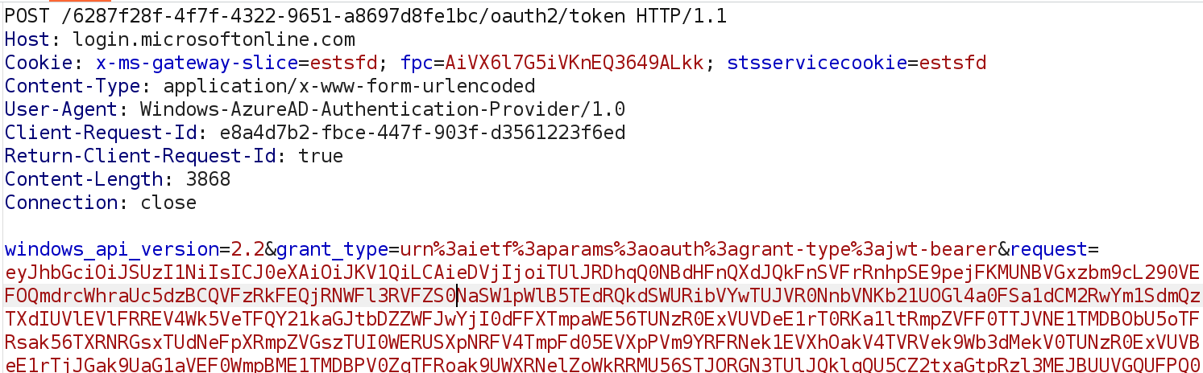
Windows Hello for Business PRT with Entra

Slide 36
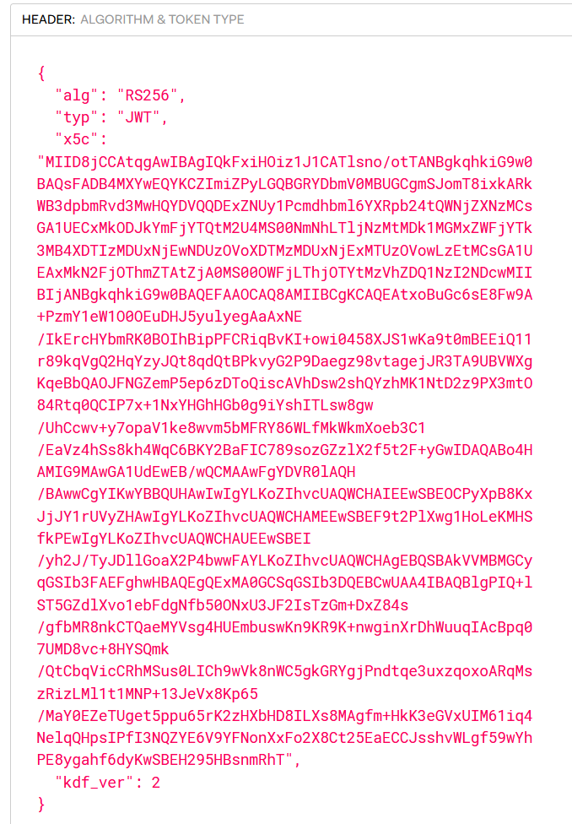
JWT header
Device certificate and signing metadata

Slide 37
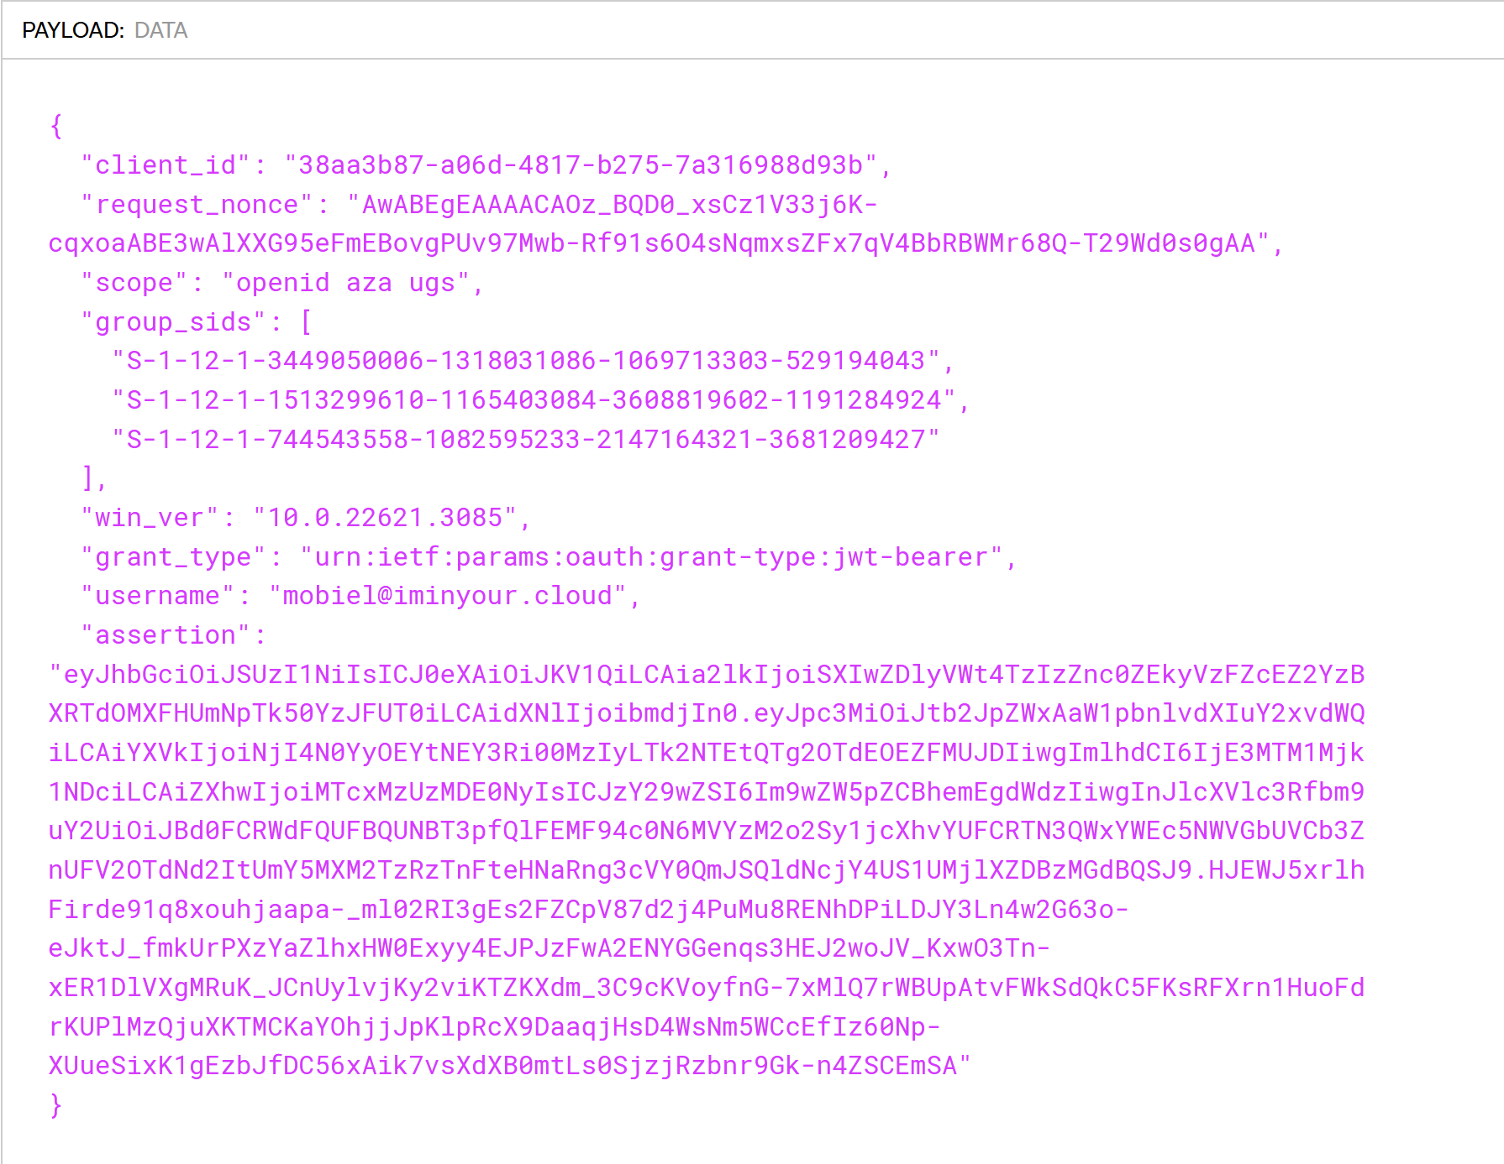
JWT Payload
Nonce from Entra
Username
Assertion (another JWT)

Slide 38
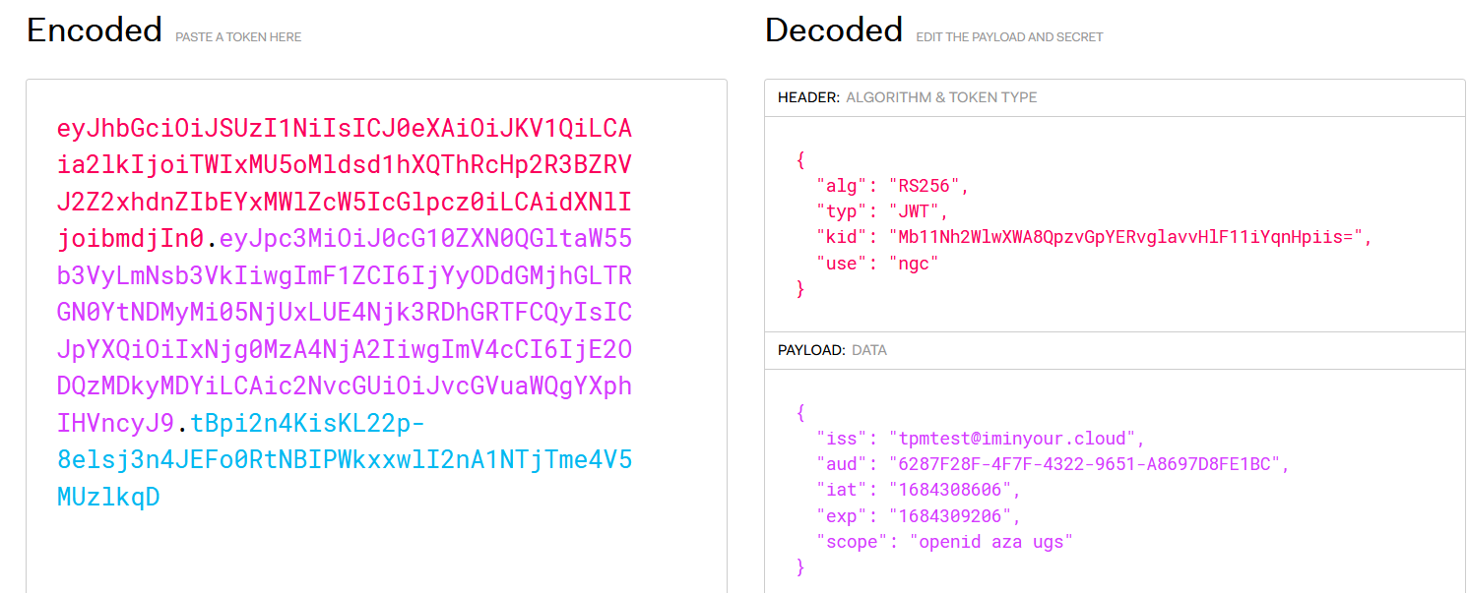
Signed assertion with WHFB private key (old)
Tenant
Timestamp

Slide 39
Generating the assertion ourselves
Windows Hello can be used from user session
We can use the Microsoft Passport Key Storage Provider from software
PIN is cached so not needed to prompt user or brute force it
Need to use native NCrypt methods since C# methods for RSA keys are limited to software keys
No admin rights needed whatsoever

Slide 40
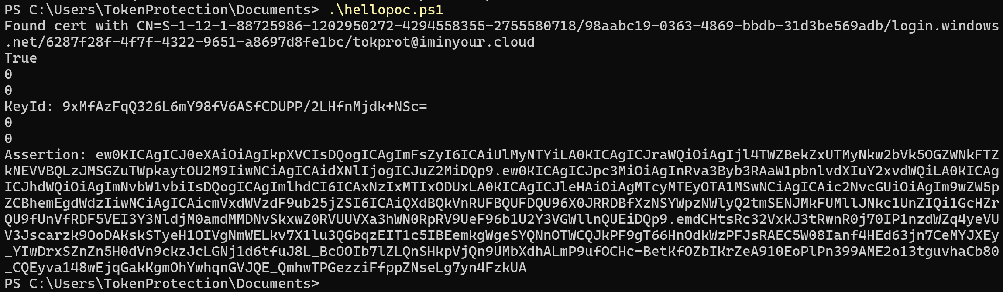
Generating assertion from user session

Slide 41
Signed assertion with WHFB private key (old)

Slide 42
WHFB attack: golden assertion
Assertion can be generated from user session without admin rights
Timestamp range can be anything, 10 years validity without problem
Assertion can be used in the future to authenticate with WHFB key
Problem: tied to device certificate and TPM?

Slide 43

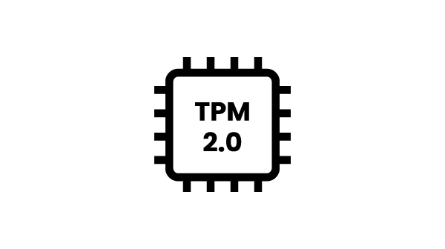


Windows Hello usage over RDP
WHFB key
User Cert + WHFB auth
WHFB PRT

Slide 44
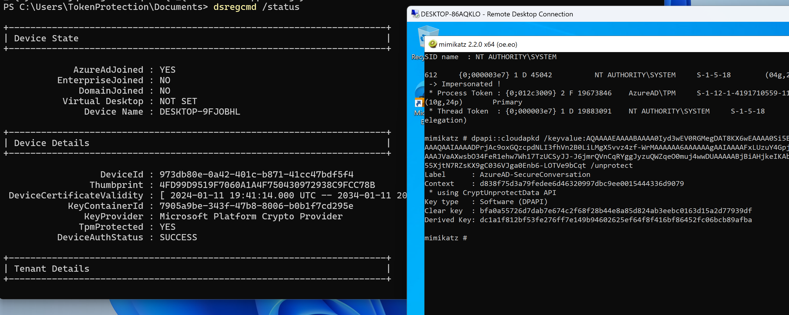
RDP to device without TPM = PRT exposure

Slide 45
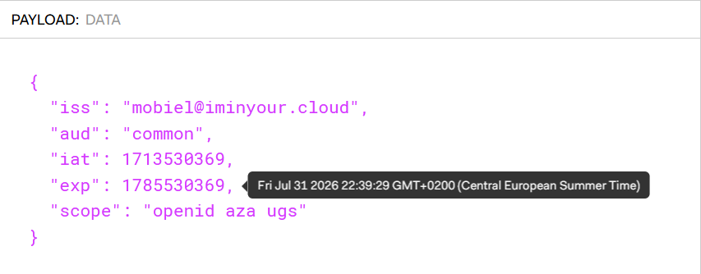
WHFB attack: golden assertion
Assertion can be generated from user session without admin rights
Timestamp range can be anything, 10 years validity without problem
Assertion can be used in the future to authenticate with WHFB key
Assertion is not tied to a device, so can be used with any other (fake) device

Slide 46
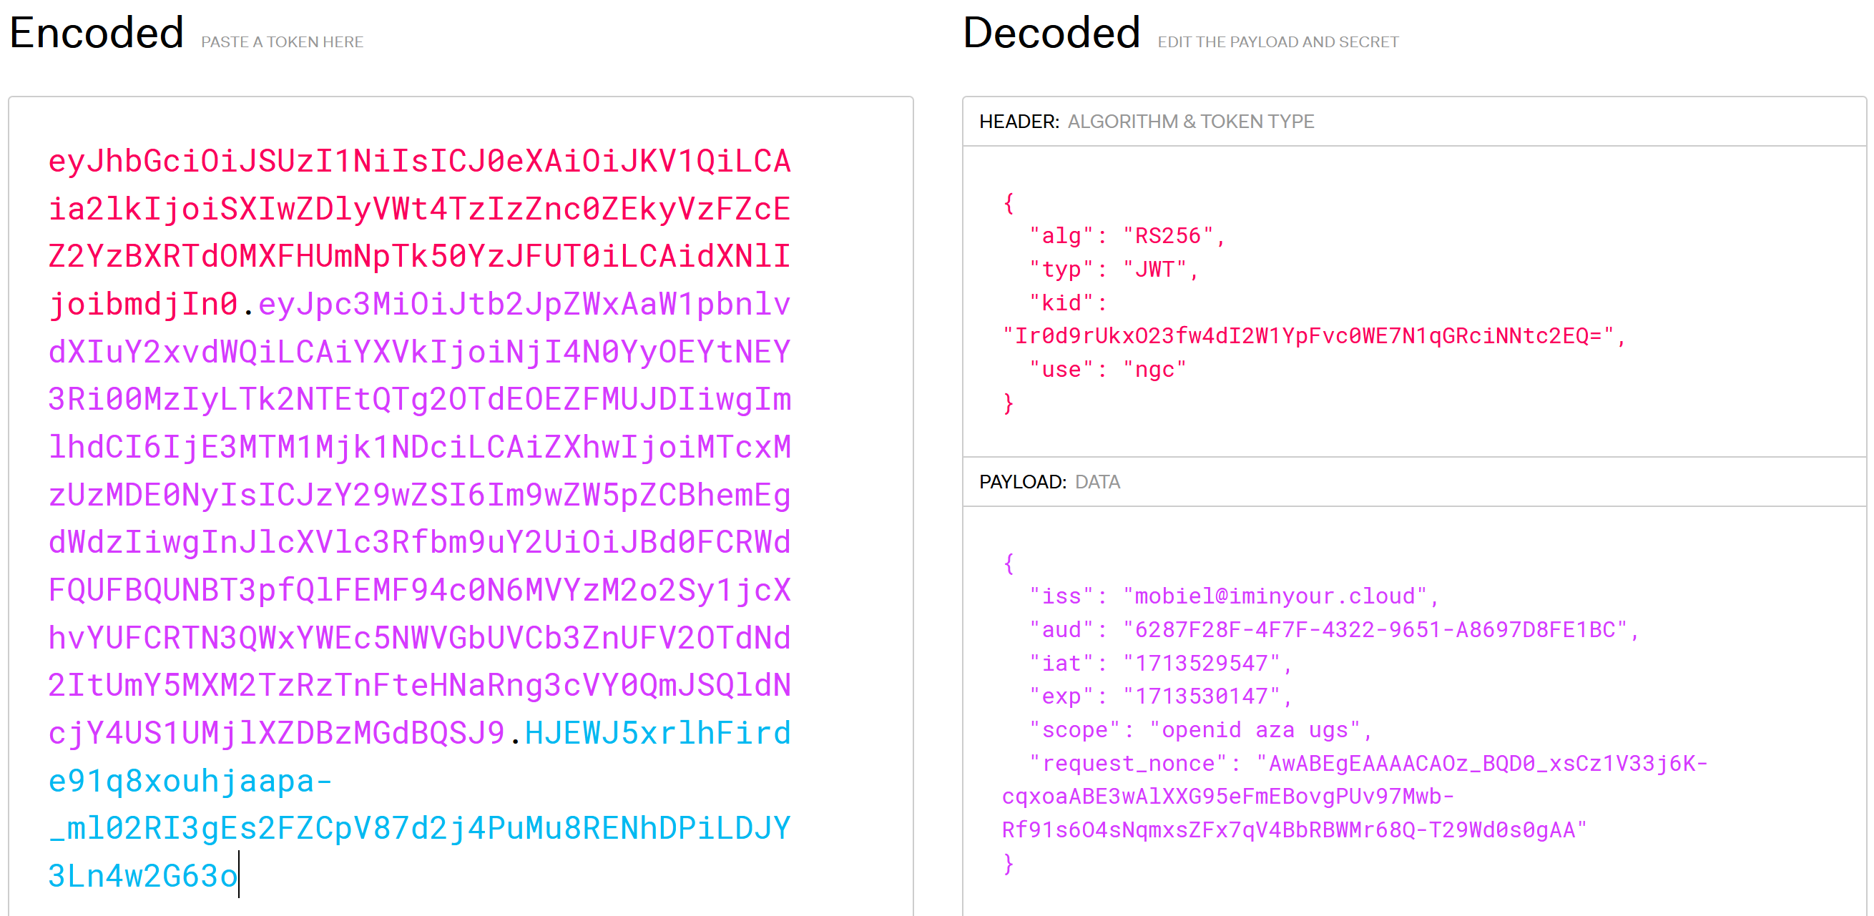
Signed assertion with WHFB private key (new)
Tenant
Timestamp
Nonce

Slide 47
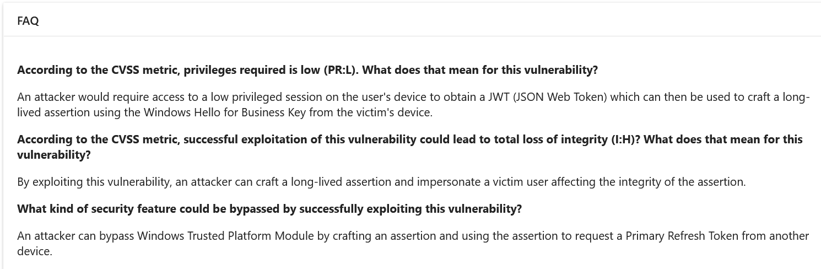
WHFB attack: golden assertion
Patched as CVE-2023-36871 and CVE-2023-35348 (AD FS) in July 2023
Windows will now include a nonce in the assertion, which limits assertion validity to 5 minutes
Attack mechanics explained in FAQ, actual server side enforcement for nonce only enabled in May 2024

Slide 48
WHFB assertion attack – remaining scenarios
Assertion time window is now limited to 5 minutes (nonce validity).
Does not stop us from requesting a PRT on a different device without TPM (part of the design).
Meaning we can still use the assertion from a victim to request a PRT on a different device, bypassing TPM protection.
PRT will have it’s regular 90 days validity and can be used to sign in to anything Entra connected.
Not mitigated by VBS, LSA PPL, Windows Hello ESS, TPM, etc

Slide 49
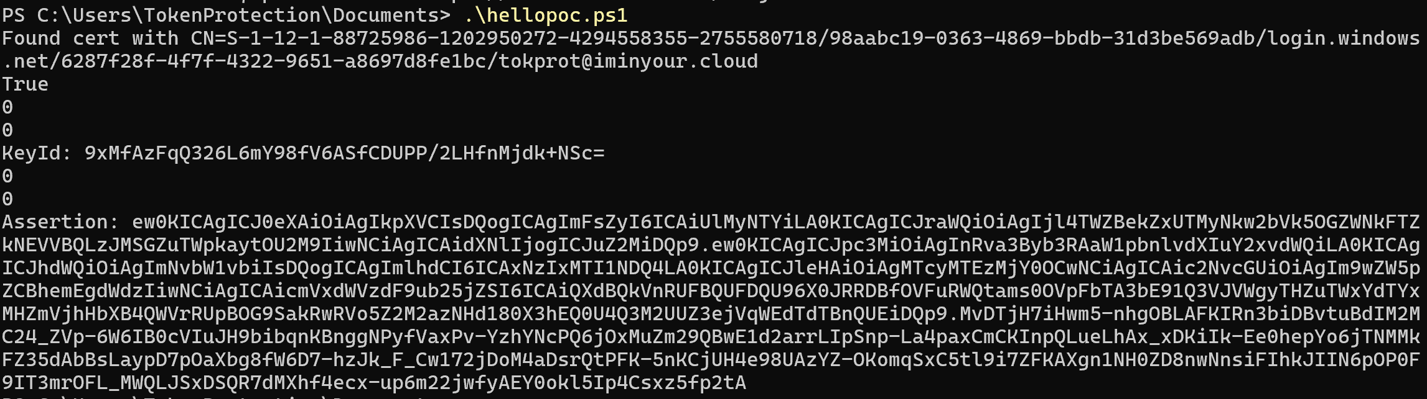
WHFB assertion stealing – From victim session

Slide 50
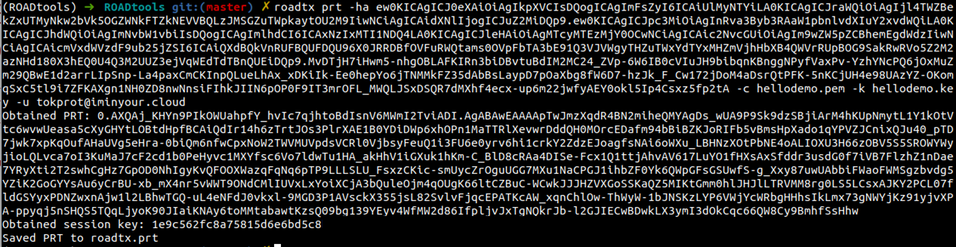
WHFB assertion stealing – attacker host

Slide 51
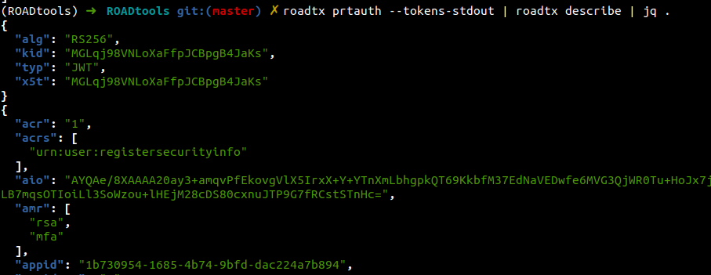
WHFB assertion stealing – token claims

Slide 52
Entra Mitigations
Require device compliance
Restrict device join / registration for regular users
Monitor for new devices + use of existing WHFB key
Don’t RDP to untrusted hosts with sensitive accounts

Slide 53
Endpoint Mitigations
Use Windows Hello ESS
Use physical key
No TPM = no Windows Hello
Alert on container file access
NgcCtrlSvc is legitimate
Other processes not so much

Slide 54
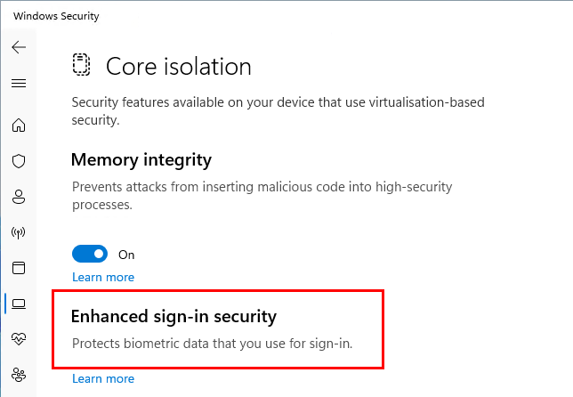
What the hell is Windows Hello ESS
Enhance Sign-In security
Launched in circa 2020
Supported on secure-core capable machines only
Hardware root of trust via SecureBoot
TPM
Kernel DMA Protection
S-RTM – Static root of trust measurement
HVCI – Hypervisor Code Integrity
SDEV and SDCP
SDEV/SDCP rarely seen in the wild
Additional hardware support needed
Namely ACPI SDEV table
Biometric readers need to support secure device capability

Slide 55
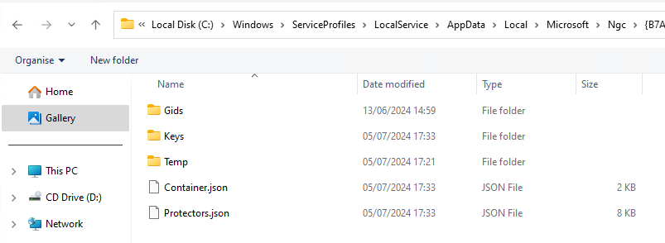
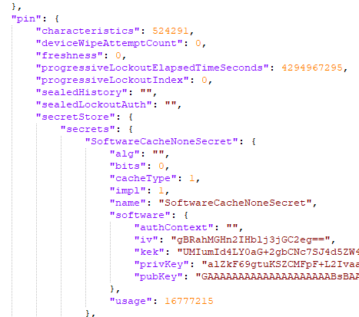
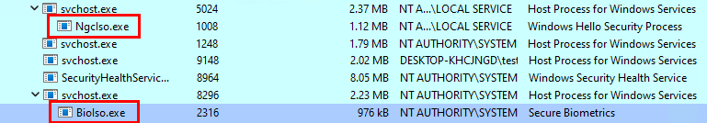
What the hell is Windows Hello ESS
Complete overhaul of NGC container, protector and key store
Metadata dat files replaced with JSON
BioIso.exe and NgcIso.exe IUM trustlets companions
Protector keys most likely never leave VTL1
More research needed

Slide 56



Shoutout & Further Reading
@DrAzureAD – AADInternals
@gentilkiwi – Mimikatz
@tijldeneut – DPAPI-NG research
https://dirkjanm.io/assets/raw/Windows%20Hello%20from%20the%20other%20side_nsec_v1.0.pdf
https://dirkjanm.io/digging-further-into-the-primary-refresh-token/
https://www.insecurity.be/blog/2020/12/24/dpapi-in-depth-with-tooling-standalone-dpapi/
https://hashcat.net/forum/thread-10461.html
https://aadinternals.com/
https://hit.skku.edu/?page_id=2233

Slide 57


Thank You!
https://github.com/CCob/Shwmae
https://github.com/dirkjanm/ROADtools

